Slide 1



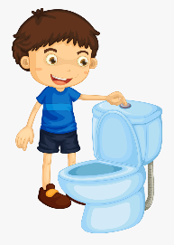



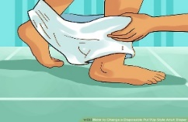

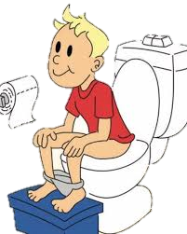
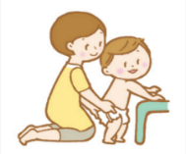

Helping your child to be ready for the toilet can take a long time
Remember:
You will need to go at a slower pace that suits your child’s needs and difficulties
Getting Ready For Toileting
Children with Additional Needs
1. Good Role Modelling
Children learn by watching and copying others.
You use the toilet, leave the door open and allow your child to observe you.
Encourage family members to get involved.
Encourage boys to sit for a wee – this will help them when going for a poo.
2. Talk About Wee and Poo
Choose the terms you want to use.
Ask everyone who looks after your child to use the same words.
Tell your child if their nappy is wet or dry when you change them.
(Talk to your child about what their wee and/or poo contains)
3. Associating Wee and Poo with the Toilet
Help your child by always changing their nappies in the bathroom.
Empty their poo into the toilet and flush it away.
Get your child to help you.
4. Use Visuals
Read toileting picture books together.
Use picture symbols and schedules to let your child know its toilet time.
5. Get your Child Motivated
Make it fun for your child.
Reward all successes, even the small ones.
Plan a reward system for example a sticker chart.
6. Develop Toilet Awareness – getting your child involved
Get your child involved with the nappy changing process.
Change your child standing up where possible.
Use your hand over their hand when changing and wiping them.
Get them to help with their clothing.
When you’ve finished, wash your hands together.
7. Seek Advice and Support
Talk to your health visitor or school nurse – they can give advice about toileting.
If you think your child is constipated – contact your GP.
ERIC’s resource guide to Bowel Problems - The ‘Poo Goes Home to Pooland’ App is good to use with your child.
Be patient
Adapted from ERIC.
Visit the Eric website: https://www.eric.org.uk/
January 2020 – Version 1.3
Specialist Nurses for Children with Additional Needs Team.

